Slide 1
Registered Nurse Baccalaureate Program
Stony Brook University School of Nursing

Slide 2
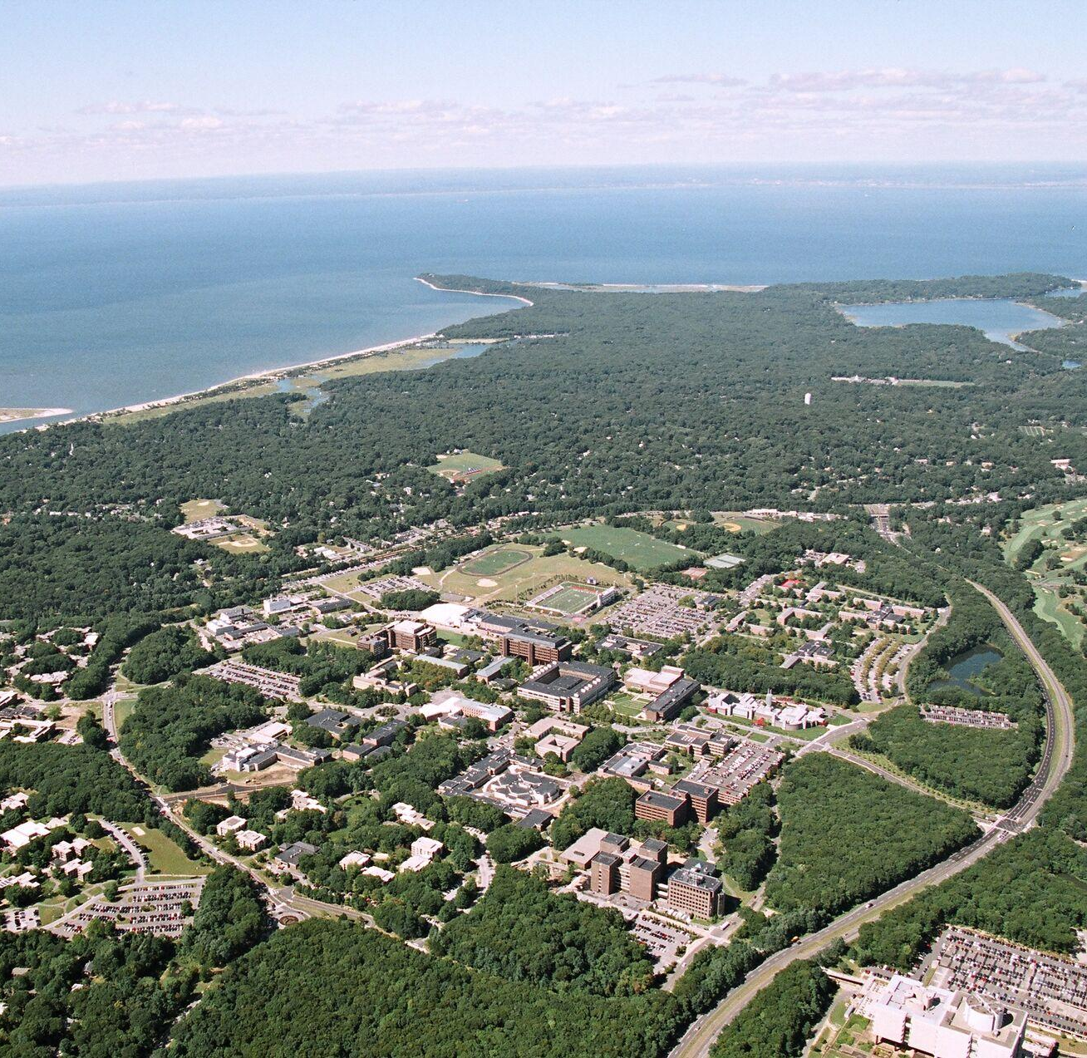
New York’s Flagship University
Health Science Center
School of Nursing
School of Medicine
School of Health Professions
School of Social Welfare
School of Dental Medicine
1,039
Acre
Campus
26,782
Total Students
18,010
Undergraduate
Students

Slide 3
School of Nursing Programs
POST-LICENSURE ACADEMIC PROGRAMS
Registered Nurse to Baccalaureate
Designed for students with an associate degree or diploma in nursing. New graduates must be licensed within six months of the start of the program
Requires 60 credits of preadmission coursework
Upon graduating, you will earn a Bachelor of Science degree with a major in nursing
Master Degree and Advance Certificate
Doctor of Nursing Practice (DNP)
PhD in Nursing

Slide 4
Registered Nurse Baccalaureate Program
Completion of the Registered Nurse to Baccalaureate Degree Program will earn a Bachelor of Science degree with a major in nursing. After being admitted into the nursing program, students will be enrolling in both upper-division nursing and liberal arts courses. Our program is designed for students with either an associate’s degree or diploma in nursing. New graduates must be licensed within six months of the start of the program
Registered Nurse to Baccalaureate Curriculum
A part-time, continuous pathway completed over two years - 60 credits taken over this time period: 3 – 11 credits per semester or session
Students with prior baccalaureate degrees in other disciplines may be eligible to apply a maximum of 19 upper-division credits (undergraduate courses numbered 300 or higher) toward the liberal arts & sciences component of the Registered Nurse to Baccalaureate degree program
Programs begin once a year starting Fall semester
Currently there are two onsite days and one virtual synchronous day. (6-8 weeks notice given for all mandatory days)
Faculty available onsite and online
A predominantly online asynchronous program
All courses are offered through the SON
Seats for all required classes are guaranteed (You can’t be closed out of a required course.)
Brightspace learning platform

Slide 5
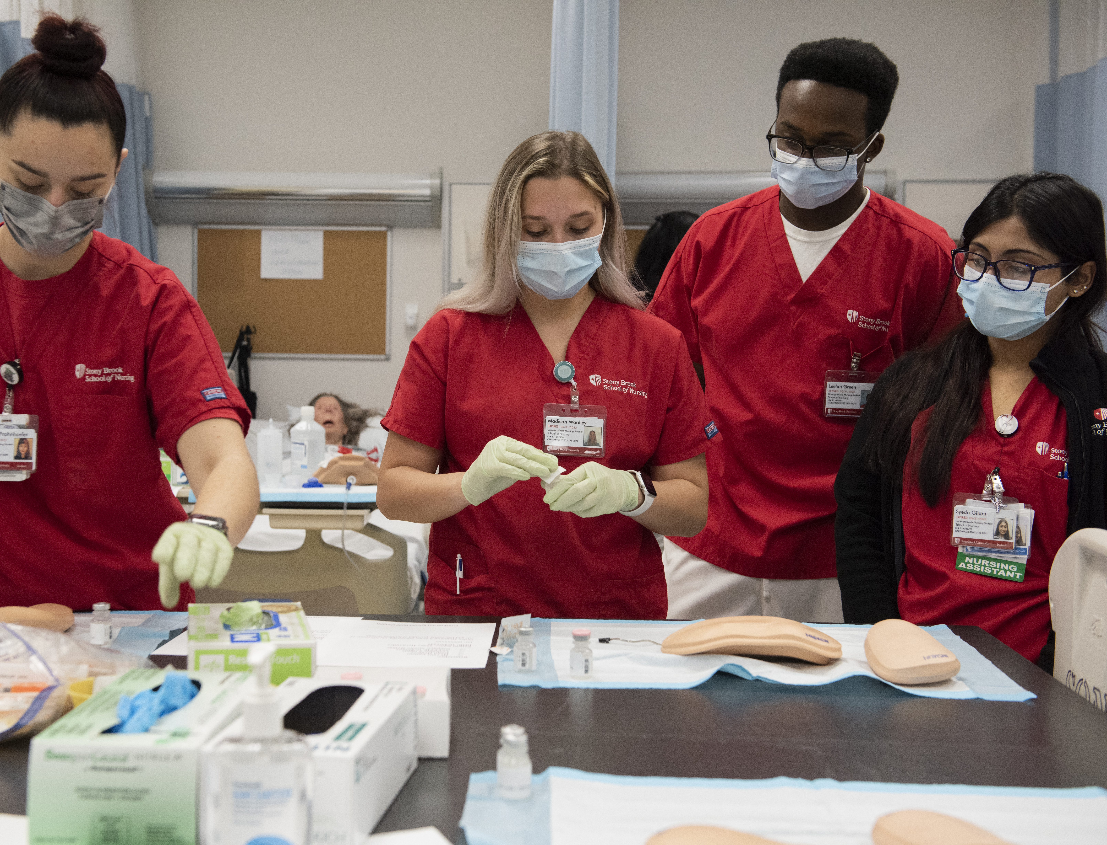
Part-Time Design of Program
All students are accepted on the part-time, continuous pathway
The two year, part-time, continuous pathway was developed for working RNs
Designed so that working students can do well and progress to competitive graduate programs
If necessary, transition to a slower pathway is possible

Slide 6
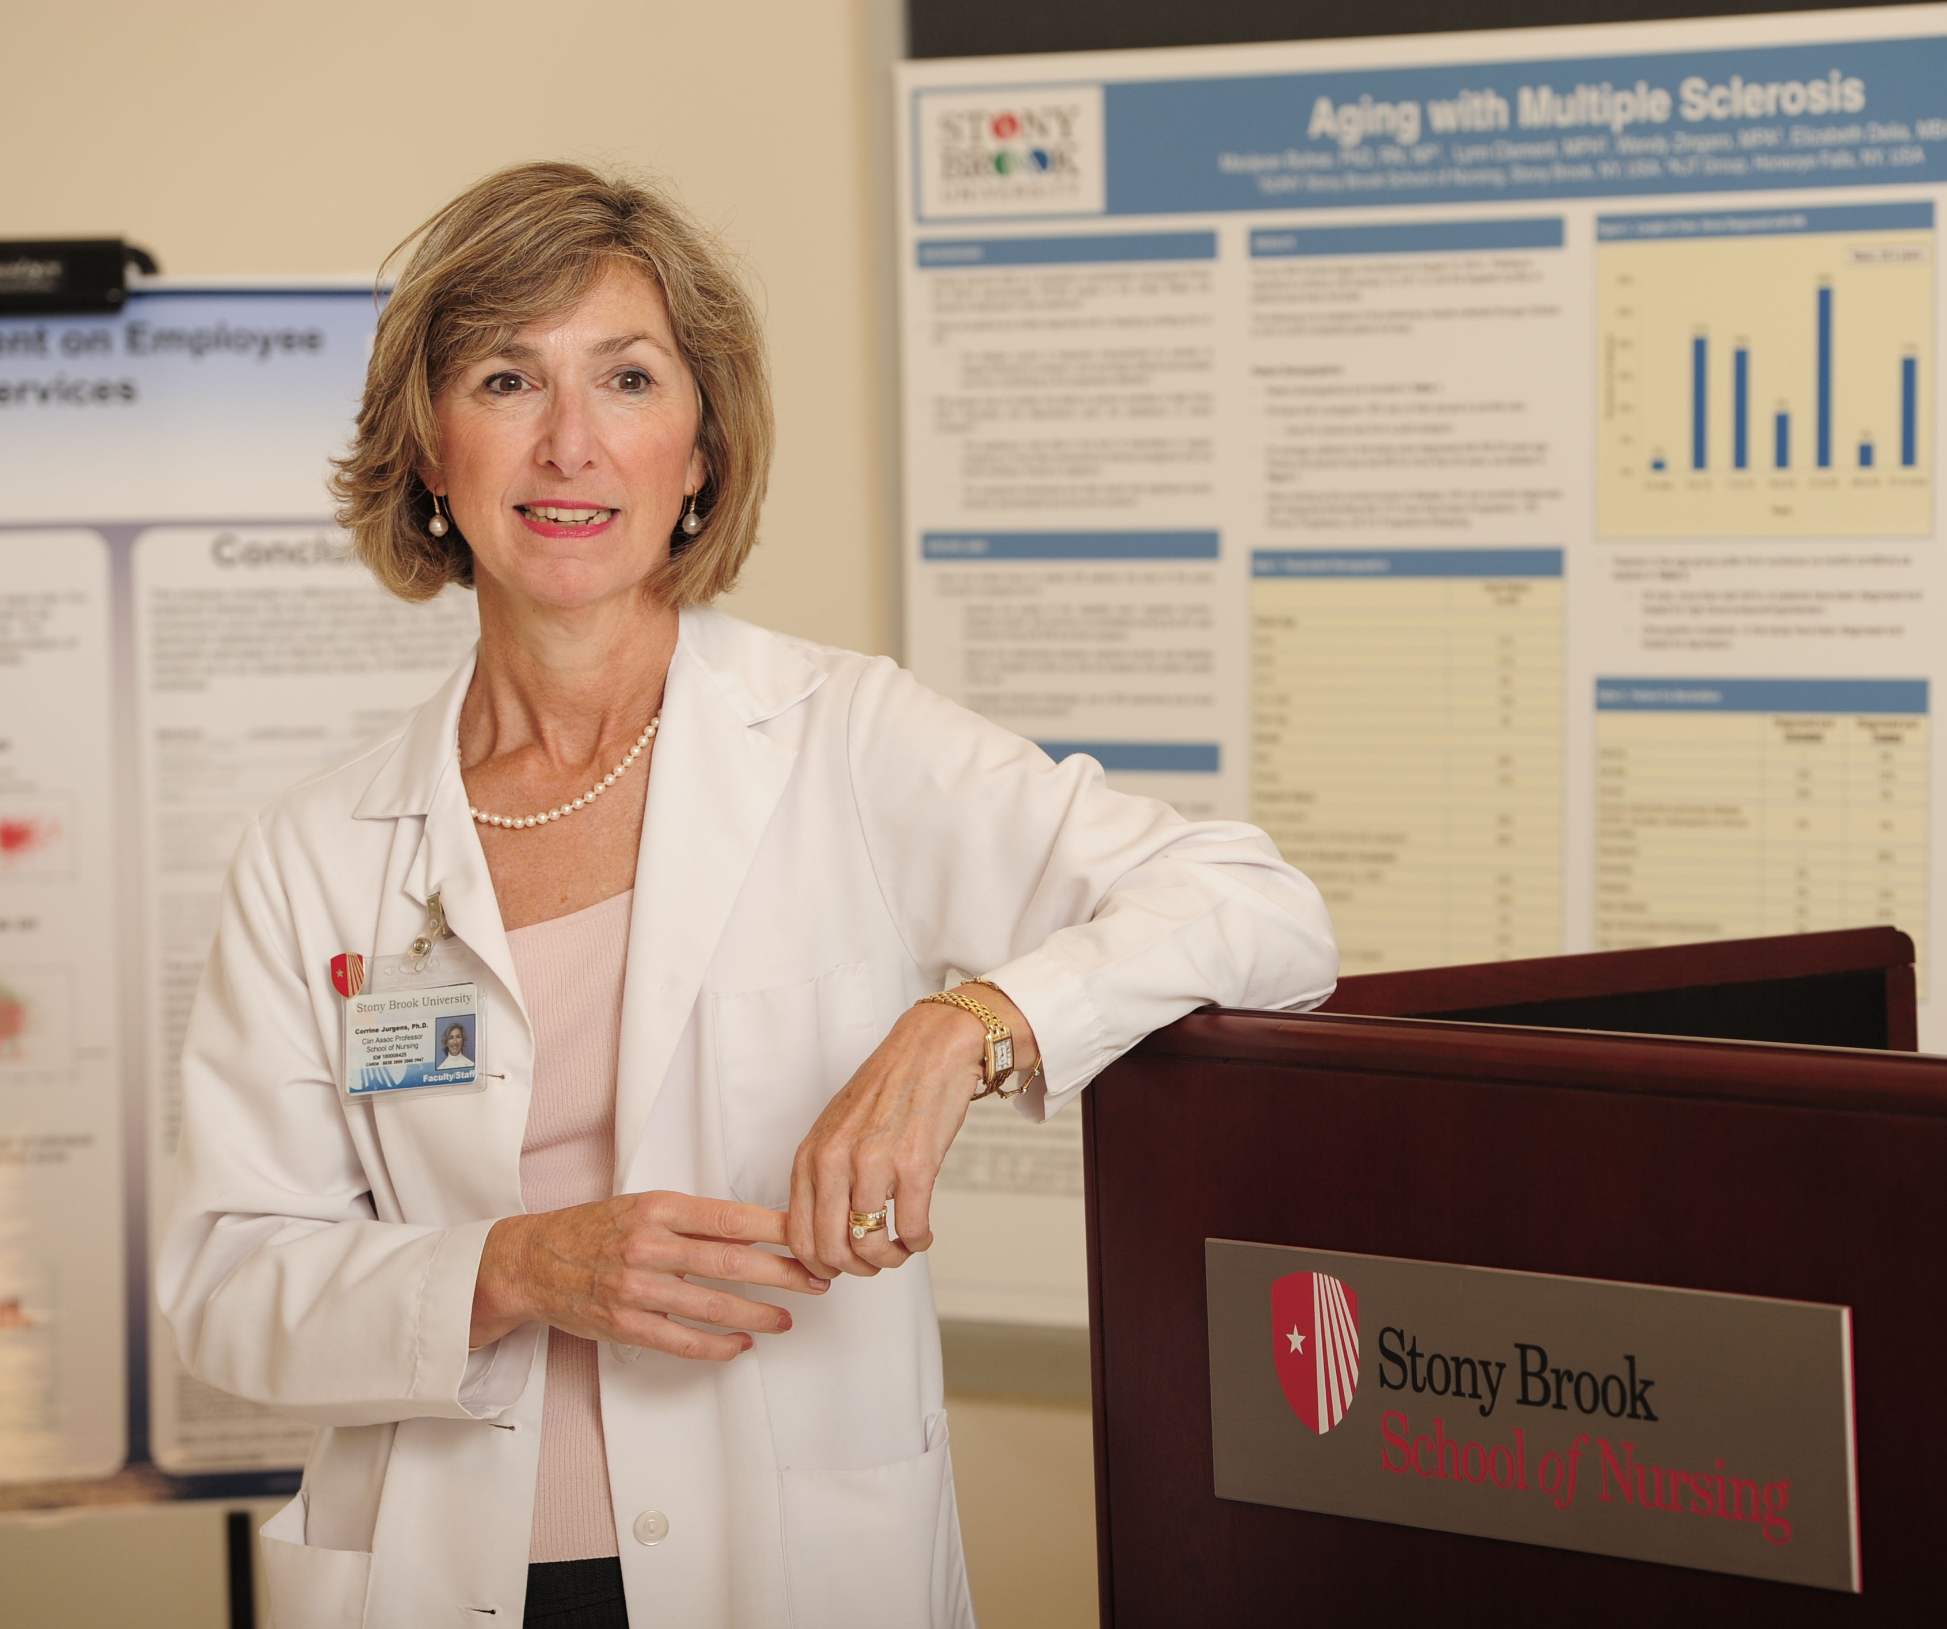
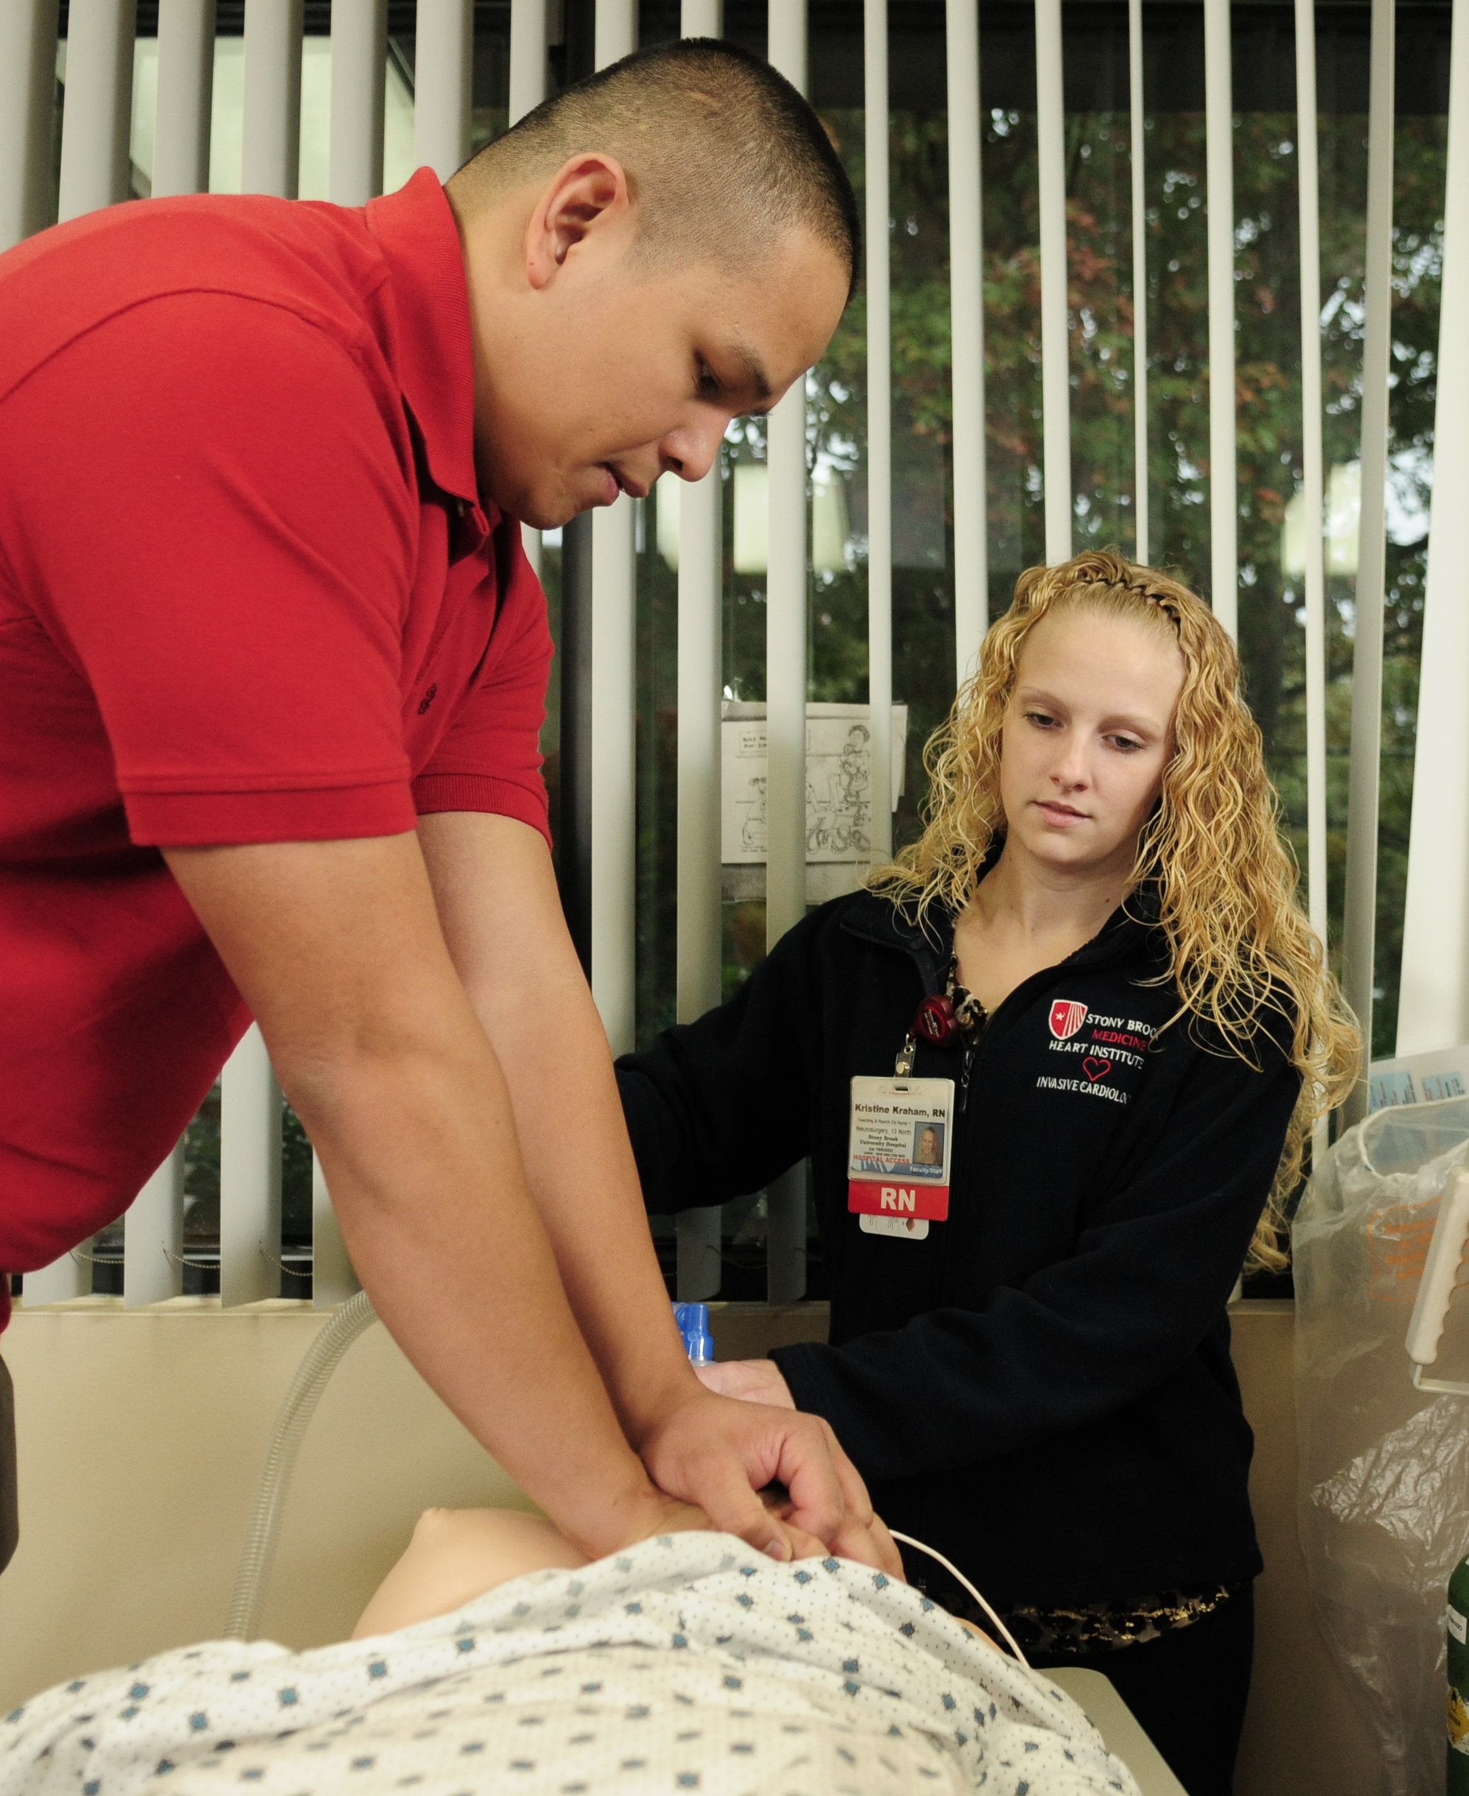
Deadlines
August 1
Application Opens
Apply via Common App or SUNY App
March 1
Application Deadline
All documents must be submitted
Program Begins Fall Semester

Slide 7
Admissions Criteria
Associate’s Degree or Diploma in Nursing
A current unencumbered New York State RN license (*Or new graduate nurses who will be licensed within 6 months of the start of the program*)
All required preadmission coursework completed with a C or higher
C- and D grades are not acceptable/transferable
Minimum cumulative G.P.A. of 2.5
Selection Process
Admission and Academic Standing Committee makes final decision regarding selections of incoming classes.

Slide 8
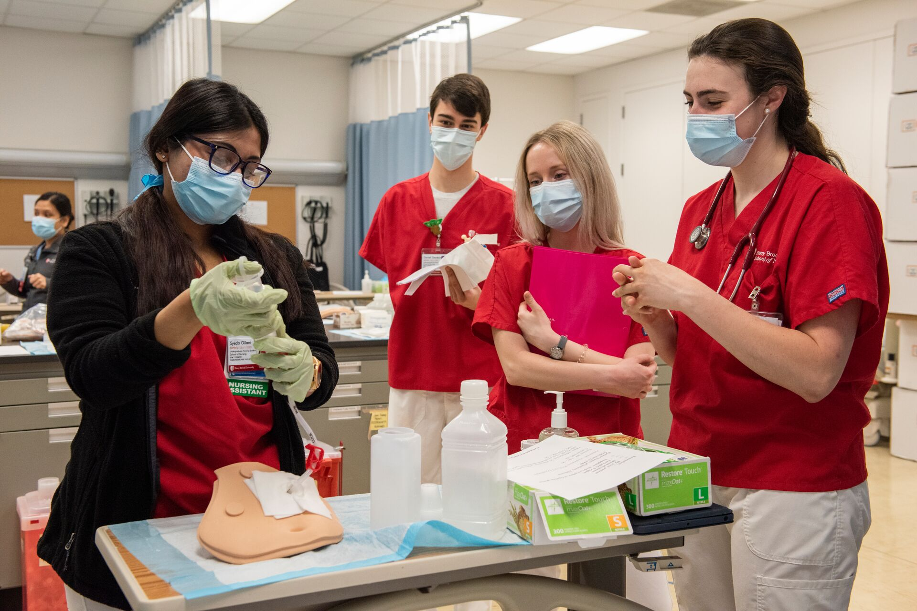
Admissions Requirements
Official transcripts from all college/universities ever attended must be uploaded to the application.
Three (3) references must be submitted with your application or emailed to enroll@stonybrook.edu
Vary your selection. Family and friends are not acceptable references.
Personal statement/essay
Resume
Completion of all preadmission coursework is required prior to starting the program
All outstanding preadmission coursework must be posted on the official transcripts and the official transcripts submitted and evaluated prior to the first day of classes *(However, new associate degree graduates will be given additional time to submit their school of nursing transcripts)*

Slide 9
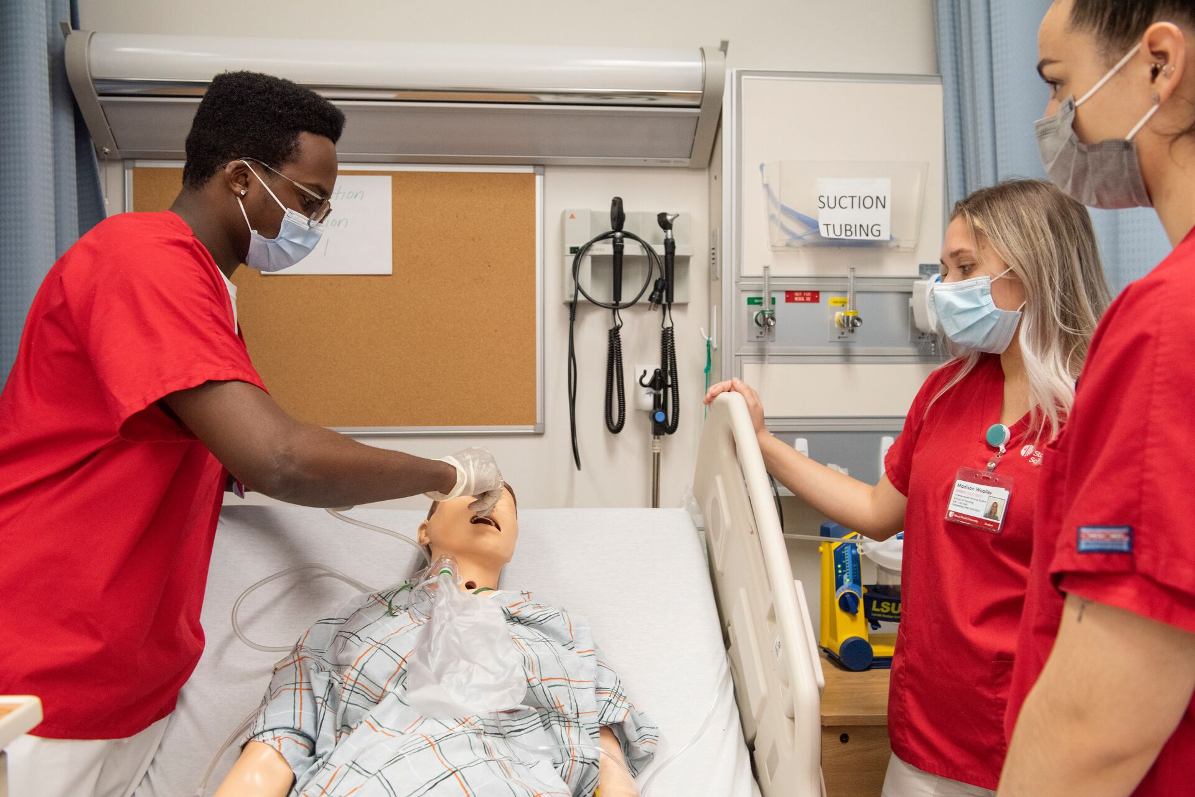
Program Admissions Requirements
Applications to the Program are required to complete only the following preadmission course work:
30 credits of Lower Division Clinical Nursing Courses
3 credits of English Composition
3 credits of Intro to Psychology
4 credits of Microbiology with Lab
4 credits of Anatomy and Physiology I with lab
4 credits of Anatomy and Physiology II with lab
3 credits of Statistics
3 credits of Humanities
3 credits of U.S. History
3 credits of Global Issues
(Total of 60 minimum credits of preadmission coursework)

Slide 10
Prerequisite Coursework
Required preadmission coursework may be taken at any appropriately accredited college/university
Many of our preadmission courses are available on OPEN SUNY: explore.suny.edu
Online classes are acceptable from appropriately accredited colleges/universities
30 Credits of Lower Division Clinical Nursing Courses
English Composition (3 credits):
Introductory writing course offered by the English Department
Also referred to as the Art and Crafts of Writing
Must transfer in as an equivalent to Stony Brook University WRT 102 Intermediate Writing Workshop.
Any other English writing course that does not transfer as WRT 102 will not satisfy the requirement
This requirement is not satisfied by AP credit scores
Introduction to Psychology (3 credits):
Must be an introductory class
Microbiology (4 credits):
• Offered by the Biology or Health Science Department • 200 level or higher
• 3 credits lecture/didactic
• 1 credit lab
• 4 credits total
Anatomy and Physiology I (4 credits) and Anatomy and Physiology II (4 credits)
• Anatomy and Physiology I and II are sequential courses
• 3 credits lecture/didactic
• 1 credit lab (2 credits total for both Anatomy and Physiology)
• 4 credits per course (8 credits total for both Anatomy and Physiology)

Slide 11
Prerequisite Coursework
Statistics (3 credits):
Acceptable transfer credits from any department; examples include Business Statistics, Psychology Statistics, Biostatistics
Research Methodology is acceptable if the course description includes statistics
Calculus does not fulfill this preadmission course
Humanities (3 credits):
Any literature, fine arts, philosophy, cultural, religion, foreign language, courses will fulfill the requirement
History classes will not transfer for the humanities
United States History (3 credits):
Any historical, political or cultural class with the course content limited to the United States will fulfill the requirement. Example: American Literature, United States Politics, United States History
World History and Western Civilization are NOT acceptable
Global Issues (3 credits):
Course content concentrates on a historical or cultural issue outside the United States and its interconnectedness to the world. Example: Western or Other World Civilizations, World History, Cultural Anthropology, World Religions
Also accepted, study abroad programs conducted by a college/university

Slide 12
Transfer Equivalencies for Prerequisites
Stony Brook University’s Transfer Equivalency Database is available online https://www.stonybrook.edu/commcms/advising/_transferinfo/equivalencies/
You can use this to determine if a course will satisfy the School of Nursing preadmission course requirements.
SBU courses that
satisfy the preadmission requirements
Required Courses | Credits | SBU Equivalency
English Composition | 3 | WRT 102
Microbiology/Lab | 4 | BIO 299
Anatomy and Physiology I/Lab | 4 | HAN 200
Anatomy and Physiology II/Lab | 4 | HAN 202
Statistics | 3 | STATS SBC: QPS
Total Credits | 18
Required Courses | Credits | SBU Equivalency
Psychology | 3 | PSY 103
Humanities | 3 | SBC: HUM
US History | 3 | SBC: USA
Global Issues | 3 | SBC: GLO
+30 credits of lower division clinical nursing courses | 30
Total Credits | 42
Overall Credits Required for Program | 60

Slide 13
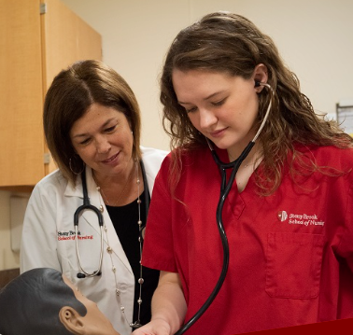
Previous Degrees and Credit Waivers
If you have a previous Baccalaureate degree in another discipline, you may be eligible to transfer up to 19 credits of your previous 300 & 400 level liberal arts courses to the RN to Baccalaureate Program, resulting in a decrease in the number of courses you must complete. Please see below for previous course/credit requirements and required materials
Only courses with a minimum grade of C+ shall be considered
These credits must be from an institution accredited by an agency recognized by the U.S. Secretary of Education
Official Transcripts and course descriptions must be submitted
Decisions regarding transfer credit are made on an individual basis
Grades received for transferred courses are not shown nor are they included in the calculation of the student’s cumulative grade point average at Stony Brook University

Slide 14
FINANCING QUESTIONS?
Tuition
Phone: (631) 632-2455
Email: studentbilling@stonybrook.edu
Financial Aid
Phone: (631) 632-6840
Email: finaid@stonybrook.edu

